Slide 1
Renaissance UAC: Year 1

Slide 2
Key Staff Supporting the Center
Tim Russell - Regional Director
Janet Viana - Program Manager
Elvira Rojas - Program Coordinator
Jerry Mathis - Program Specialist
Notes:
We ave

Slide 3
Program Launches & Successes
28 Unique ARPA participants have received Supportive Services [Goal 70; 40%]
10 Unique ARPA participants engaged in business startup activities [Goal 24; 42%]
10 Unique ARPA participants received a cash stipend of $1,500 [Goal 70; 14%]
28 Unique ARPA participants enrolled into Capital Workshops [Goal 90; 31%]
Notes:
We have done this through our strong core programming - providing 4-week classes on the Business Model Canvas and 10-week Business Planning classes. We not only work with entrepreneurs to build their mindset and build their business, we also want them to build a community with each other.
Some special highlights beyond our core programming include launching programming in Cantonese, supporting various certifications (green biz, MBE/WBE and DBE), supporting immigrant entrepreneurs through SEED and distributing the California Microbusiness Covid-19 Relief Grant, which provided $2500 grants to microentrepreneurs whose gross revenues were less than $50,000.

Slide 4
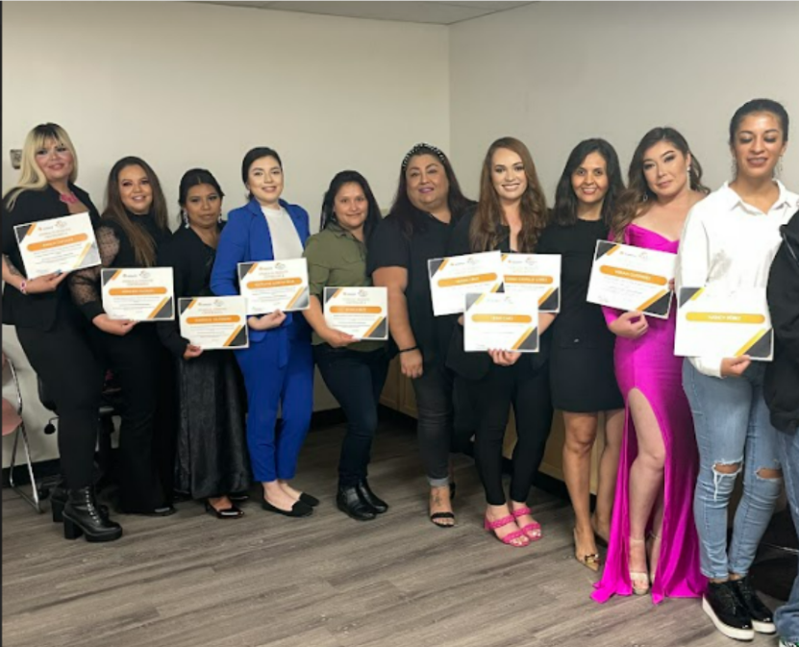
Program Launches & Successes
We successfully completed a 10-week course “Business Planning” (Planeacion de Negocios) on June 28th. The course had a total of 16 participants, and 14 qualified for the SEED 2.0 Micro Grant up to $10k.
Notes:
We have done this through our strong core programming - providing 4-week classes on the Business Model Canvas and 10-week Business Planning classes. We not only work with entrepreneurs to build their mindset and build their business, we also want them to build a community with each other.
Some special highlights beyond our core programming include launching programming in Cantonese, supporting various certifications (green biz, MBE/WBE and DBE), supporting immigrant entrepreneurs through SEED and distributing the California Microbusiness Covid-19 Relief Grant, which provided $2500 grants to microentrepreneurs whose gross revenues were less than $50,000.

Slide 5
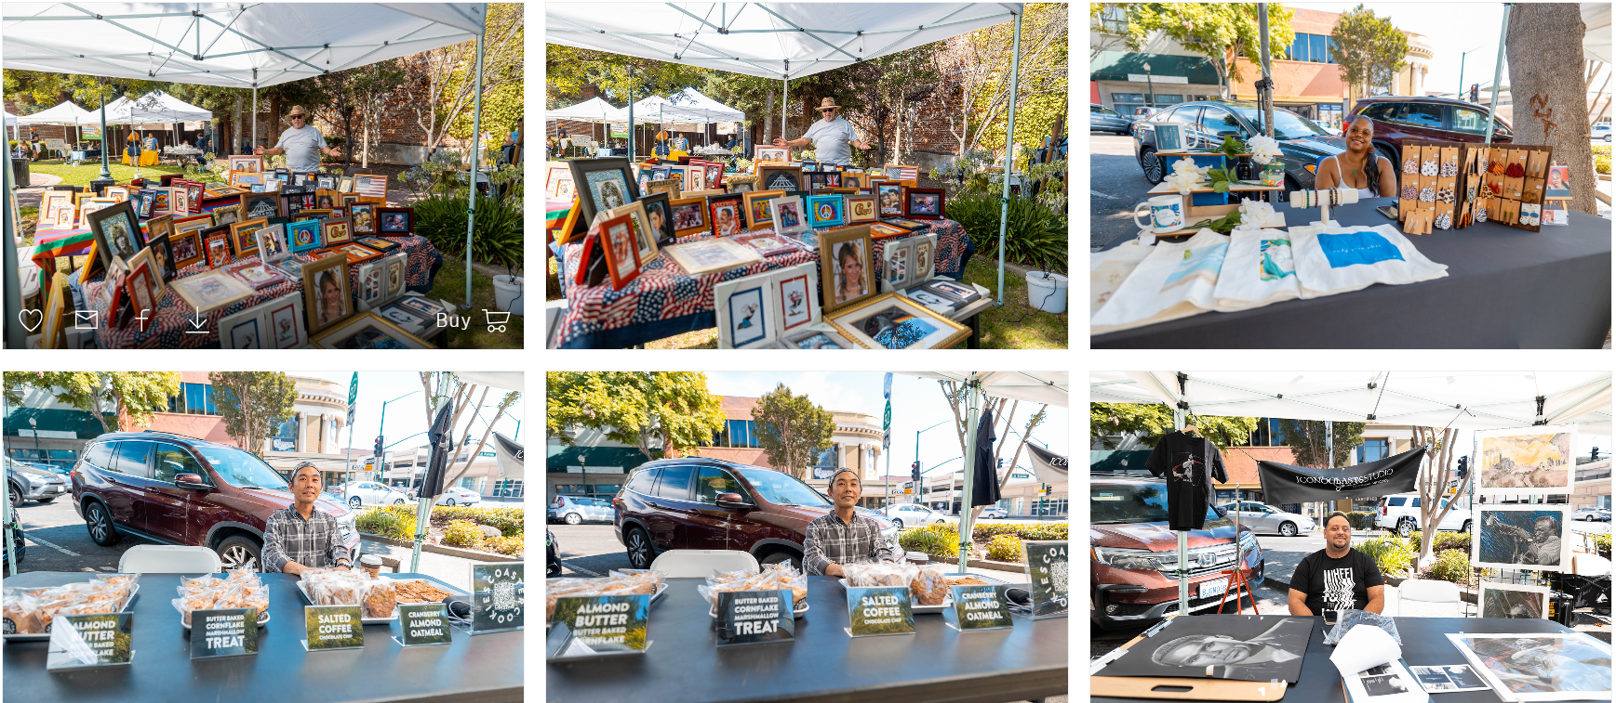
Marketplaces
Notes:
We have done this through our strong core programming - providing 4-week classes on the Business Model Canvas and 10-week Business Planning classes. We not only work with entrepreneurs to build their mindset and build their business, we also want them to build a community with each other.
Some special highlights beyond our core programming include launching programming in Cantonese, supporting various certifications (green biz, MBE/WBE and DBE), supporting immigrant entrepreneurs through SEED and distributing the California Microbusiness Covid-19 Relief Grant, which provided $2500 grants to microentrepreneurs whose gross revenues were less than $50,000.

Slide 6
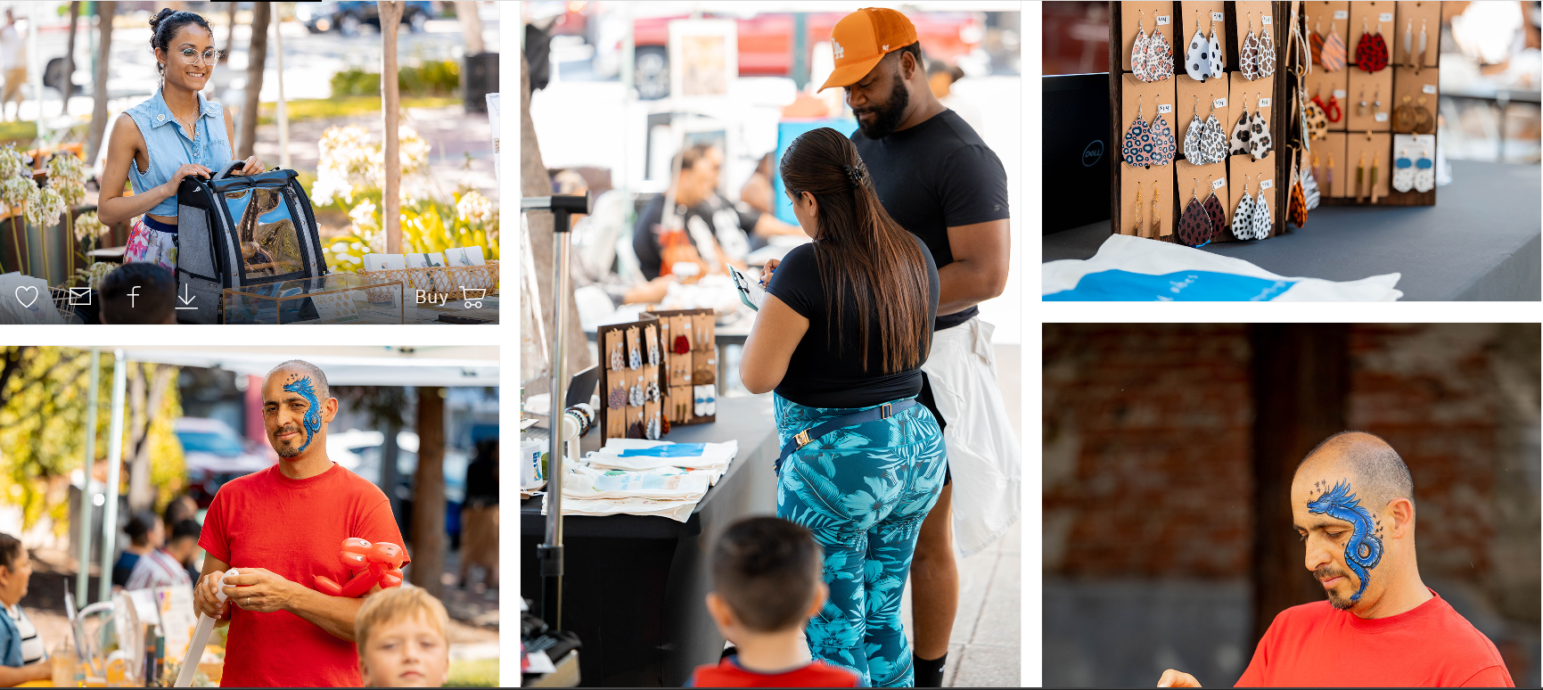
Marketplaces
Notes:
We have done this through our strong core programming - providing 4-week classes on the Business Model Canvas and 10-week Business Planning classes. We not only work with entrepreneurs to build their mindset and build their business, we also want them to build a community with each other.
Some special highlights beyond our core programming include launching programming in Cantonese, supporting various certifications (green biz, MBE/WBE and DBE), supporting immigrant entrepreneurs through SEED and distributing the California Microbusiness Covid-19 Relief Grant, which provided $2500 grants to microentrepreneurs whose gross revenues were less than $50,000.

