Slide 1


CONSTRUCTION TRADES WORKFORCE INITIATIVE
The Nonprofit Partner of The Building Trades-East/North Bay

Slide 2

Agenda
Mission & Role
Key Projects
SB1: Regional Leadership
SLUSD: Youth Pre-Apprenticeship
Bay Area Wide Apprenticeship Guidebook
Small/Minority Contractor Resources
Q&A

Slide 3
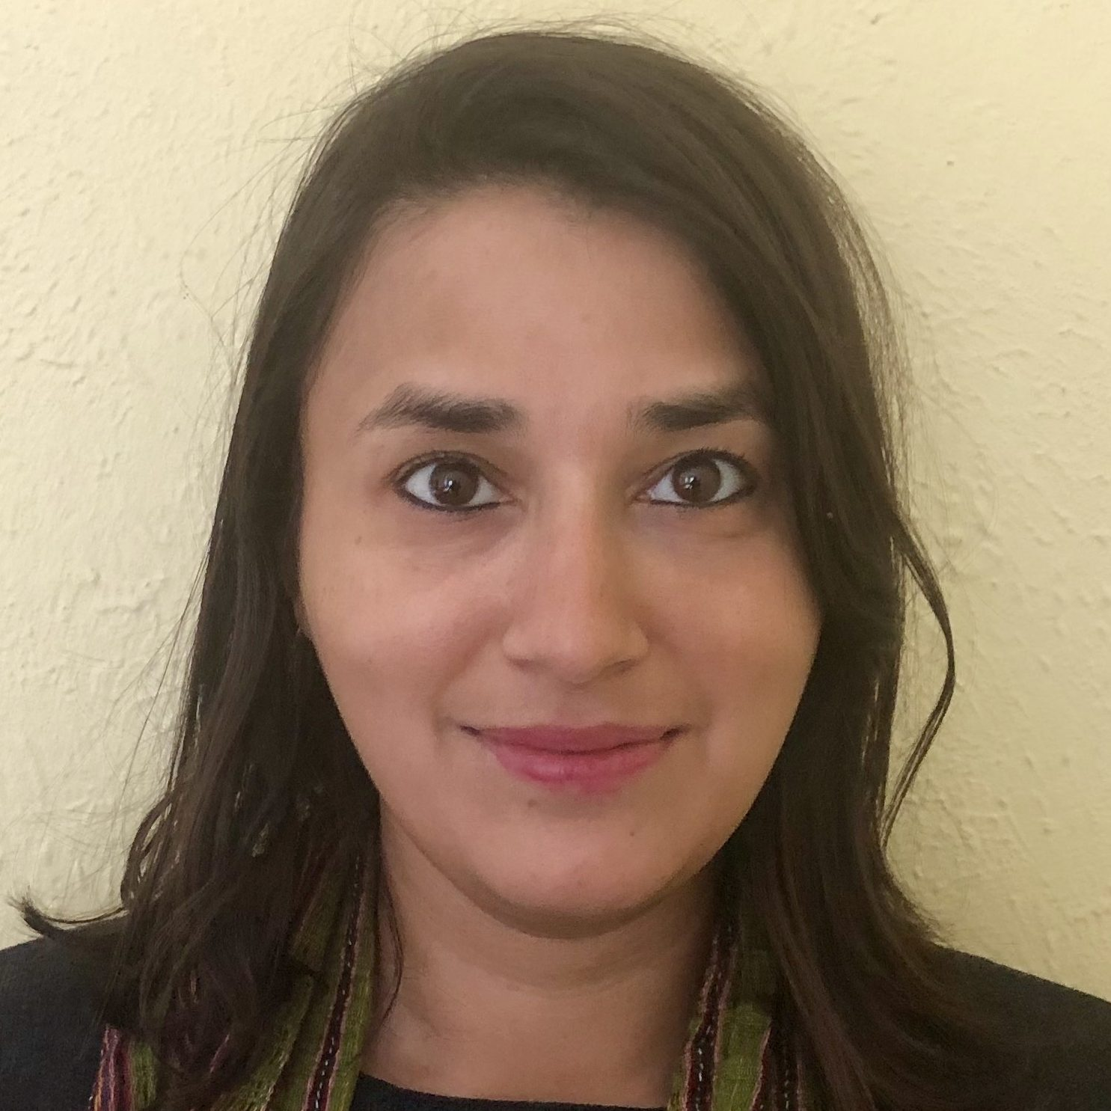
Hello!
Beli Acharya
Executive Director
Construction Trades Workforce Initiative

Slide 4
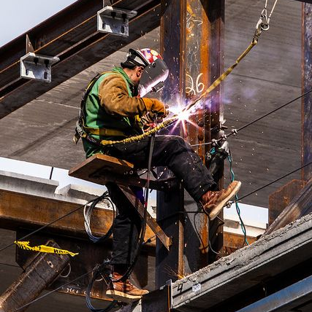
MISSION
Advance economic & social justice
by strengthening pathways to
union construction trades
Workforce Policies
Pre-Apprenticeship Programs
Education and connection to Trades

Slide 5
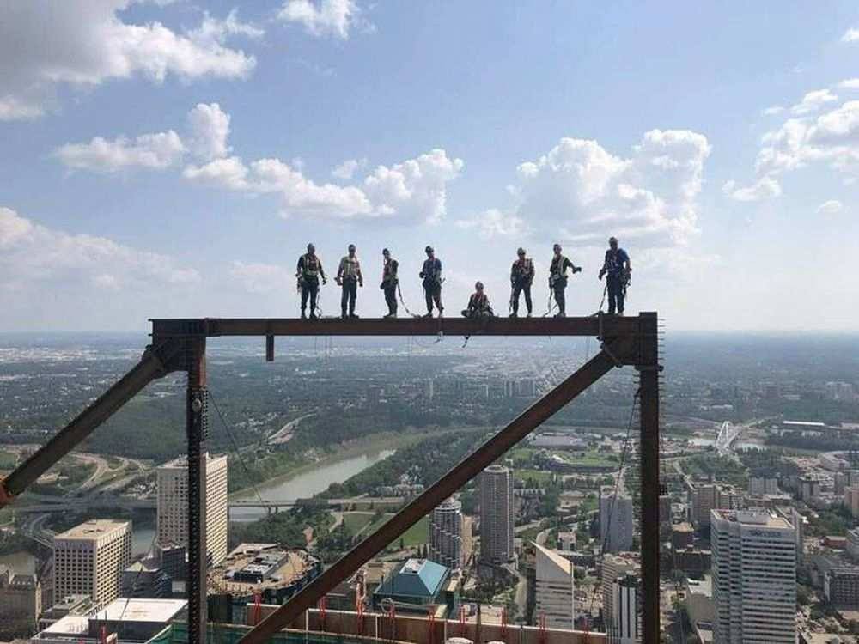
Role and Scope
1
High Road Construction Careers (HRCC): State Bill 1 (SB1) -
An Overview
Notes:
Who we are, what we are doing - an outline

Slide 6

EBRTP’S Goal
Our REGIONAL Strategies
Provide low-income individuals in the East Bay experiencing barriers to employment—
particularly women, people of color, and those who have been impacted by the justice system—
with a pathway out of poverty and into economic self-sufficiency.
Strengthen Training Programs and Program Outreach
Overcome Barriers to Employment
Make Policy Work for Local Communities
Focus on Women, Underrepresented Minorities, and the Formerly Incarcerated
Notes:
East Bay Regional Trades Program’s (EBRTP) Objective - REGIONAL APPROACH
EBRTP’s objective is to creat a regional approach thatincreases participation and enrollment of underrepresented and disadvantaged populations into family sustaining careers in the high road construction industry by strengthening our regional workforce pipeline through focused policy change, labor demand, interorganizational agreements and coordination, and improvement of MC3 construction training programs

Slide 7







Regional Partners - EBRTP
Rising Sun
RichmondBUILD
Cypress Mandela
Future Build
Tradeswomen, Inc.
Center for Employment Opportunities
Notes:
See partner listing for ALL partners - copy of application Form 2 for listing

Slide 8


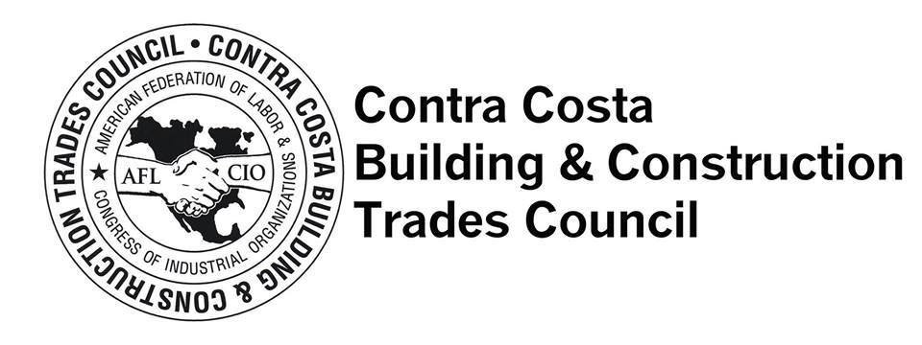


Regional Partners - EBRTP
East Bay Regional Planning Unit (Alameda, Contra Costa, Oakland, and Richmond Workforce Development Boards)
Alameda Building Trades Council
Contra Costa Building Trades Council
Bay Area Apprenticeship Coordinators Association (BAACA)
.
Oakland Adult and Career & Education (OACE)
Contra Costa Community College District (4CD)
Notes:
See partner listing for ALL partners - copy of application Form 2 for listing

Slide 9

Outcomes Overview: Regional
# SERVED
Total Youth: 25 (5%)
Total System Impacted: 135 (27%)
Total Underserved Racial/Ethnic: 390 (78%)
Total Women: 185 (37%)
Total Number of Individuals Enrolled in MC3:
500
Total Number of MC3 Graduates:
350 (70% rate)
Notes:
Alter background

Slide 10
San Leandro Unified
2
MC3 Pre-Apprenticeship Program at Lincoln HS

Slide 11

MC3 Pre-Apprenticeship
25 juniors and seniors (9 female)
Community Education Workshops, Hands-on and
Soft-skills trainings
Leveraging City and School District PLAs
Developing Post Graduation Pathways
Implementing 3 Week Summer Trades Program

Slide 12
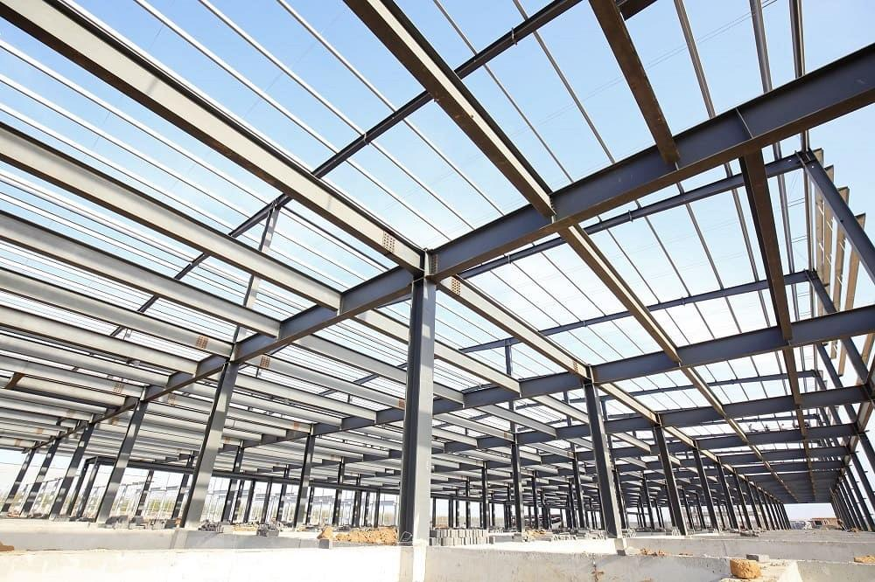

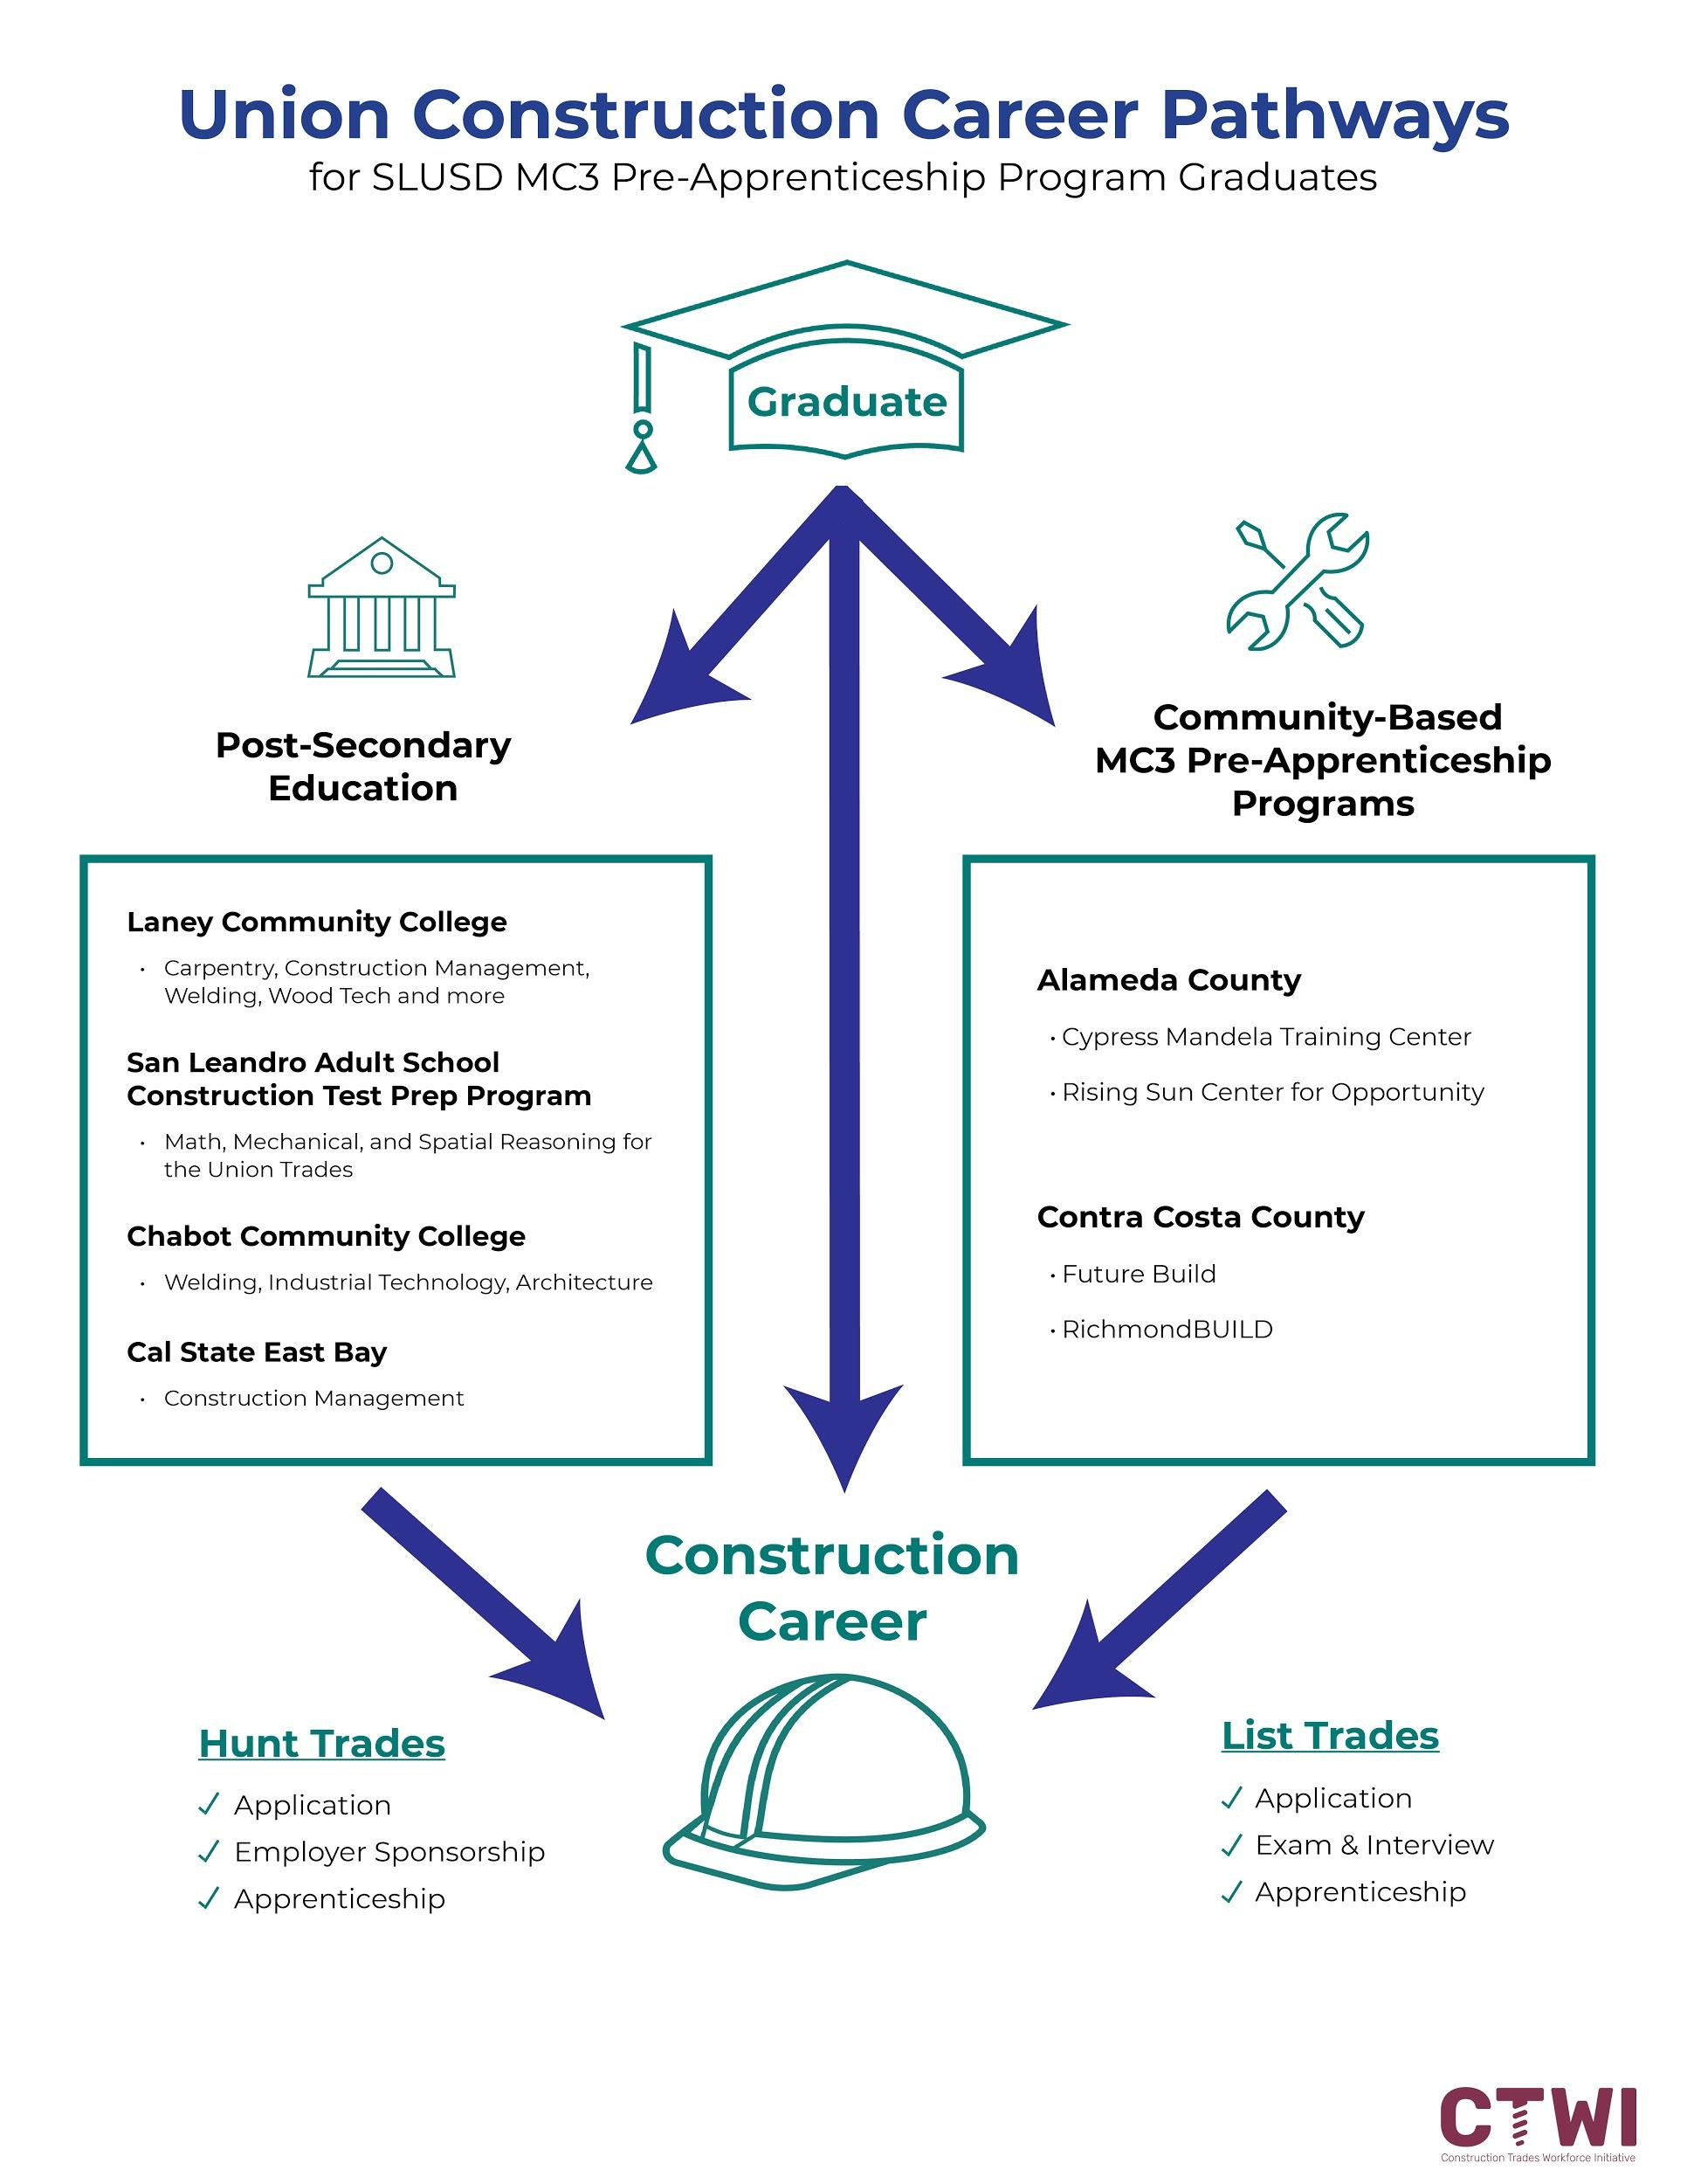

Slide 13
Bay Area Apprenticeship Guidebook
3

Slide 14
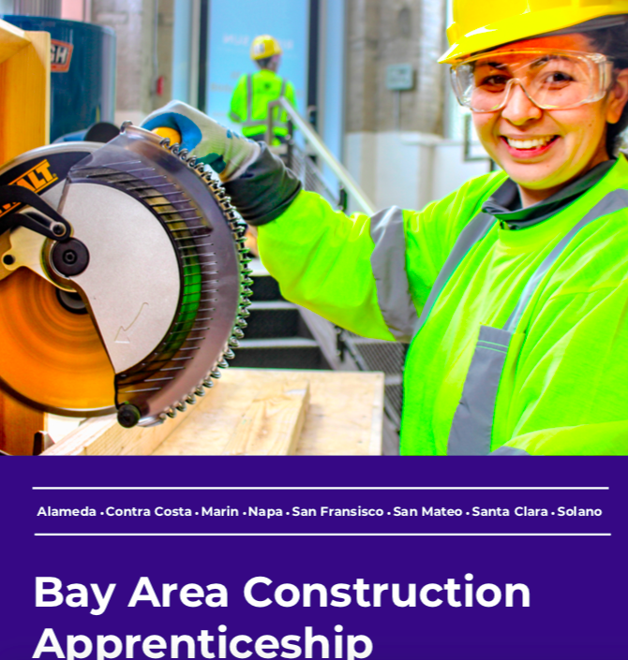

Slide 15
GUIDEBOOK
QUICK FACTS
Partnership w/ Bay Area Apprenticeship Coord. Assoc.
Covers 8 Bay Area Counties
Includes Apprenticeship & Pre-Apprenticeship requirements, application steps, wages contact info
Utilized by Workforce Boards, Organizations, School Districts, Job Seekers, Unions, Elected Officials
Available In Hard Copy and Digital Copy available end of May

Slide 16
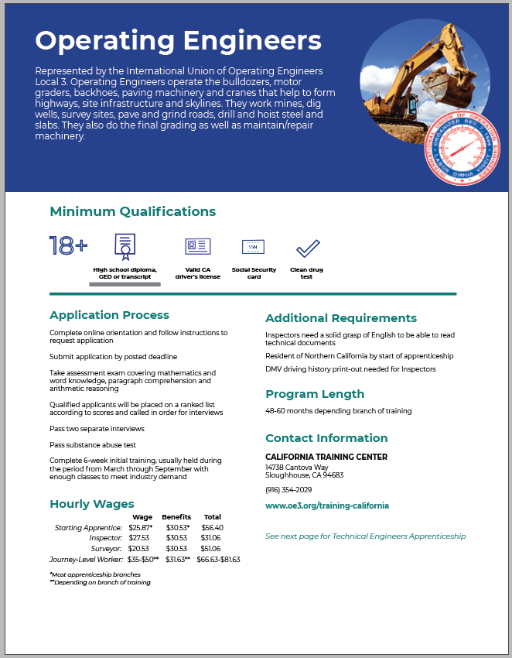

Slide 17
Small Business Resource
4

Slide 18
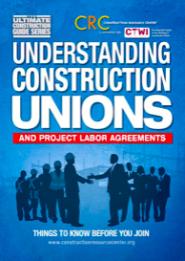

Slide 19
Unions & PLA Textbook
QUICK FACTS
Partnership w/ Construction Resource Center (Turner Group Construction)
Resource for small and minority contractors to help contractors make informed and strategic decisions
Available In Hard Copy and Digital Copy available. Course material taught through Workshops
Notes:
This guidebook provides critical information and insights from a contractor’s perspective on the following topics:
– Unpacking Project Labor Agreements
– The benefits of becoming a union contractor
– Concerns and advice addressing common questions
– Master Labor Agreements
– Contractor associations
– Small and Local Business Enterprises
– Benefits and challenges of working on Project Labor Agreements
– Best practices for contractors

Slide 20

Q&A
More Questions?
Contact:
Beli Acharya
Beli@ctwi-btca.org
646.338.7367

